Slide 1
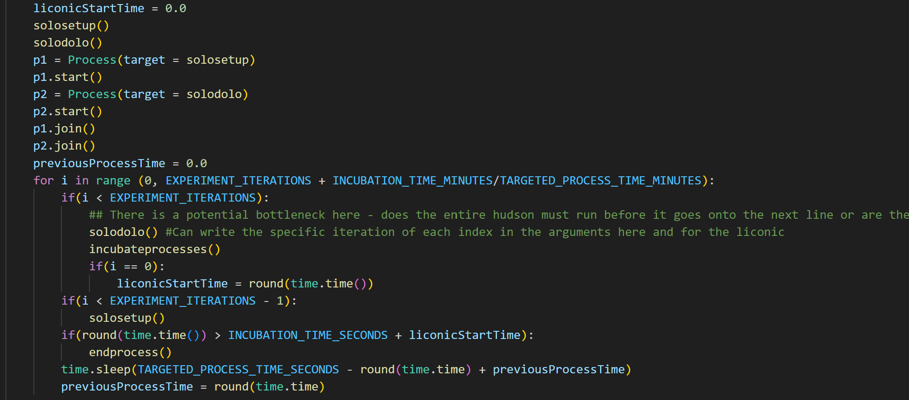
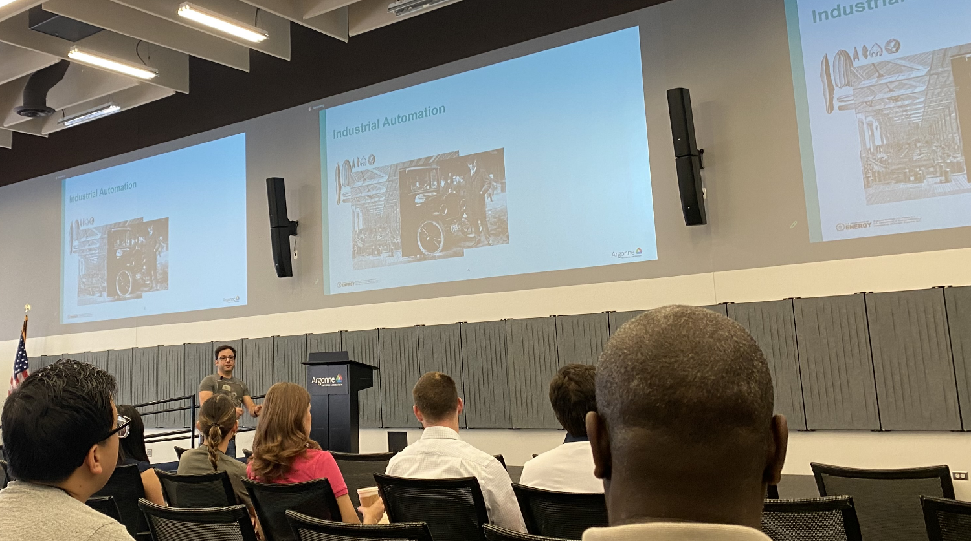
Multiple Loops + Parallelization:
Updates:
Executed Basic Workflow + Learned About In-depth Procedures using Wei
Completed Training Modules
Created C# Script for Sending Tip Refilled Command to Hudson Solo
Unsure where to execute this, Hudson script makes sense and is currently C#, but we want to write it in Python
Developed First and Second Iteration Code to translate Bio Workflow into Parallel Workflow
Executing Tasks in Parallel to Optimize Time Spent for Multiple Wells
Current Setup:
Zero State:
1. Transfer to Hudson
2. Hudson Experiment
3. Set Aside Well Plate
Every Other State:
1. Transfer to Hudson
2. IN PARALLEL:
Hudson Experiment AND Transfer Aside to Incubator if present then Read another plate after incubator if after incubation time and present
3. Set Aside Well Plate
Questions + Concerns:
Worried about PlateCrane hitting Solo since they are working at the same time, especially during incubation. Is there a way to mitigate this?
Is there a way I can receive GitHub Access? Currently, I am not able to push and pull to branches.
Future Steps:
Learning about Globus, Further Testing Parallel Structure, Data Analytics from Hidex to Eventually Close Loop
Hey Raf!

